Slide 1
LIVING IN NY

Slide 2
Introduction
My name is Luca and i come from Milan, Italy. I've always lived in Italy and for us a good espresso coffee is fundamental. In order to find the best espresso in Milan I tried out many coffees and once I've chosen the best one i stick with it. Now I'm going to live in New York. The culture of coffee is different in other countries and I'm afraid I won't be able to find enough coffee shops in NY. That's why I want to apply what I've learned so far to discover a neighbor where there're enough coffee shops in NY like Milan.

Slide 3
Data
List of Boroughs and neighborhoods of Milan with their geodata;
List of Boroughs and neighborhoods of Manhattan with their geodata;
List of coffee shops of Milan with their geodata;
List of coffee shops of Manhattan with their geodata.

Slide 4
Methodology
Data preprocessing
Location Extraction
N° of cafes extraction

Slide 5
Results
Location extraction results
Number of cafes results

Slide 6
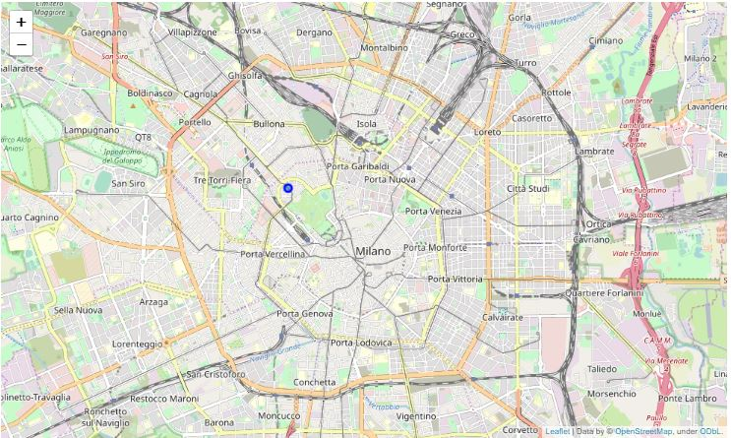
My Milan district

Slide 7
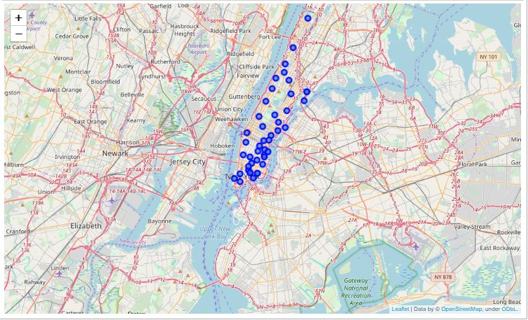
Districts in Manhattan

Slide 8
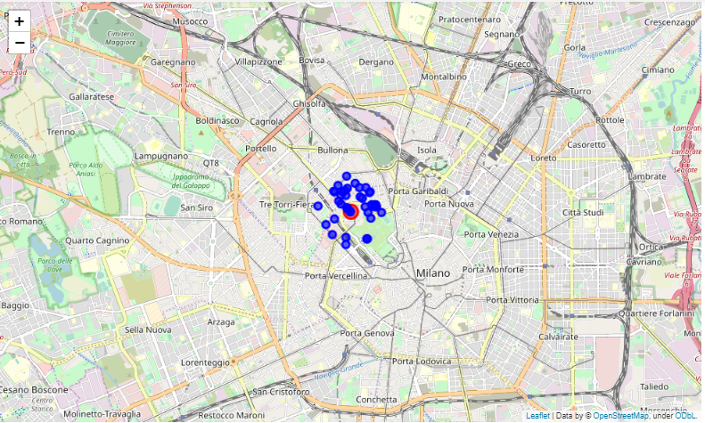
Number of cafes in Milan

Slide 9
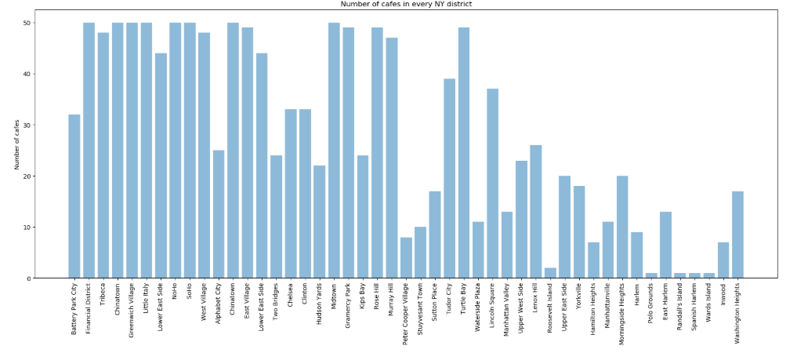
Number of cafes in NY

Slide 10
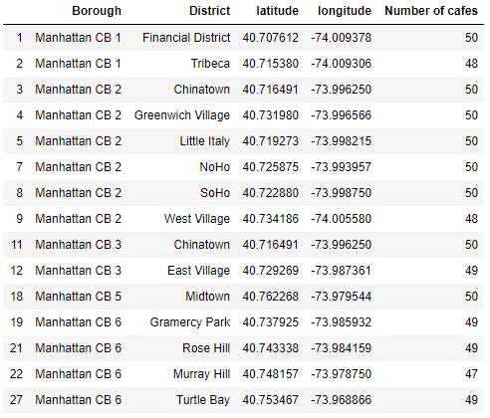
Number of cafes for every district with an amount higher than Milan

Slide 11
Discussions
High number of districts in Manhattan with an high concentration of cafes.
More than one district is suitable for me

